Slide 1

Global Insurance Agency
Database Design
QUICK SILIVER support
Hanxin Dong/ Yichen Pan/ Yuxuan Wang/ Shuangjie Ma

Slide 2

YICHEN PAN
HANXIN DONG
YUXUAN WANG
SHUANGJIE MA

Slide 3
DATABASE DESIGN CONCEPT

Slide 4
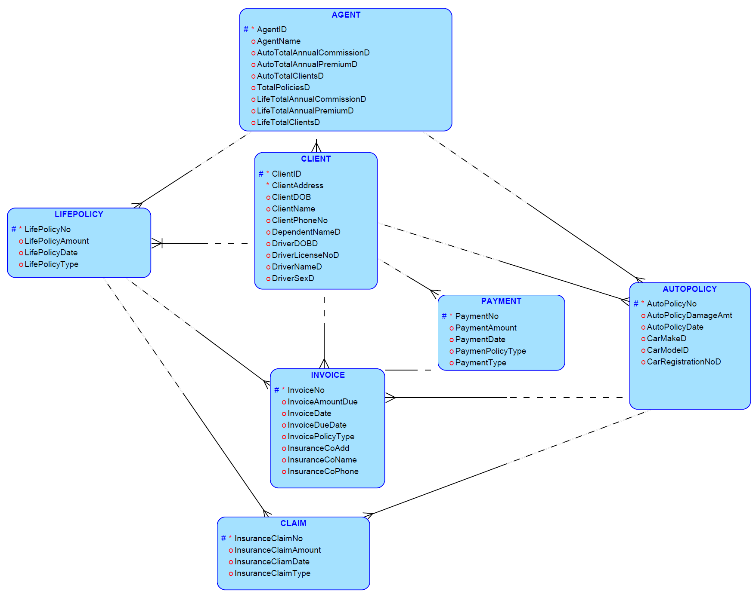
Entities
AGENT
CLIENT
INVOICE
CLAIM
PAYMENT
AUTOPOLICY
LIFEPOLICY

Slide 5
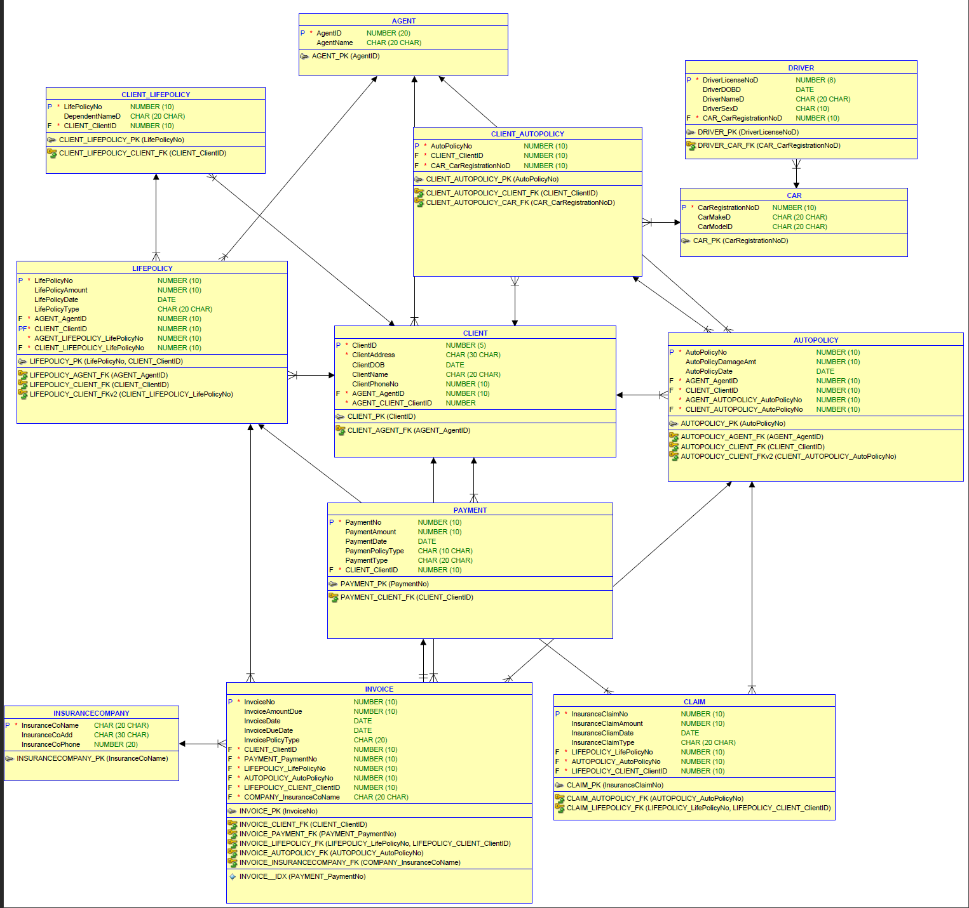
New Tables
INSURANCE-COMPANY
CAR
DRIVER

Slide 6
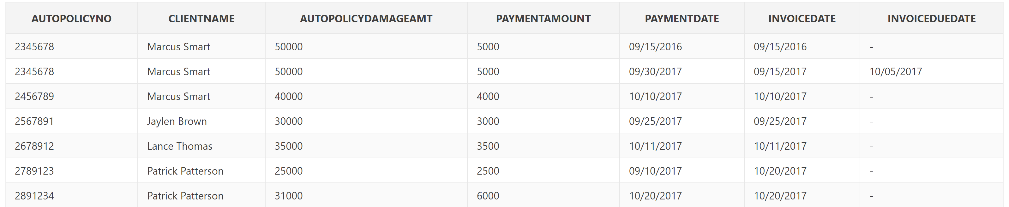
1.We want to know if there any client misses the due date to pay for their insurance and also their insurance fee and coverage.
Note: Clients who first apply to the insurance don’t have invoice due date. For people normally get invoice after they pay the first term insurance fee.

Slide 7
3 Step Approach To Database Design
Create Conceptual Model
Create Physical Model
Develop Database Application
Notes:
Conceptual model: Entity relationship Model

Slide 8
Database Design Procedure
Entity Relationship Model
Generate Database Application
Relational Model
Notes:
Conceptual model: Entity relationship Model

Slide 9

ENTITIES
LIFEPOLOLICY
LifePolicyNo
LifePolicyNo
LIFEPOLOLICY
LifePolicyNo
LifePolicyNo
LIFEPOLOLICY
LifePolicyNo
LifePolicyNo
LifePolicyNo
LifePolicyNo
LIFEPOLOLICY
LifePolicyNo
LifePolicyNo
LifePolicyNo
LIFEPOLOLICY
LifePolicyNo
LifePolicyNo
LifePolicyNo
LifePolicyNo
LifePolicyNo
LifePolicyNo
LifePolicyNo
LifePolicyNo
LifePolicyNo

Slide 10
ENTITY RELATIONSHIP DIAGRAM
LIFEPOLOLICY
AGENT
LifePolicyNo
AgentID
LifePolicyAmount
AgentName
LifePolicyDate
AutoTotalAnnualCommissionD
LifePolicyType
LifePolicyNo
LIFEPOLOLICY
LifePolicyNo
LIFEPOLOLICY
LifePolicyNo
LifePolicyNo
LIFEPOLOLICY
LifePolicyNo
LifePolicyNo
LifePolicyNo
LifePolicyNo
LifePolicyNo
LifePolicyNo
LifePolicyNo
LifePolicyNo
LifePolicyNo

Slide 11

SQL QUERY NO.1
SQL QUERY NO.1

Slide 12

NORMALIZATION
Original Realtional Model
LIFEPOLOLICY
LifePolicyNo
LIFEPOLOLICY
LIFEPOLOLICY
LifePolicyNo
LifePolicyNo
LifePolicyNo
LifePolicyNo
LifePolicyNo
LifePolicyNo
LifePolicyNo
LifePolicyNo
LifePolicyNo
LifePolicyNo
LifePolicyNo

Slide 13
NORMALIZATION
Normalized Realtional Model
LIFEPOLOLICY
LifePolicyNo
LIFEPOLOLICY
LIFEPOLOLICY
LifePolicyNo
LifePolicyNo
LifePolicyNo
LifePolicyNo
LifePolicyNo
LifePolicyNo
LifePolicyNo
LifePolicyNo
LifePolicyNo
LifePolicyNo
LifePolicyNo

Slide 14
SQL QUERY NO.1
SQL QUERY NO.2

Slide 15

TABLE ——CLIENT

Slide 16
TABLE ——CLIENT

Slide 17
SQL QUERY NO.1
SQL QUERY NO.3

Slide 18
TABLE ——CLIENT

Slide 19
TABLE ——CLIENT

Slide 20
SQL QUERY NO.1
SQL QUERY NO.4

Slide 21
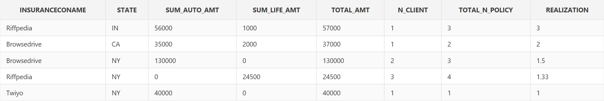
We want to do a Market situation analysis of the insurance company on state level

Slide 22
select insuranceconame, state, sum_auto_amt, sum_life_amt, total_amt, n_client, total_n_policy, round((total_n_policy / n_client),2) as realization from
(select insuranceconame, state, sum_auto_amt, sum_life_amt, (sum_auto_amt+sum_life_amt) as total_amt, n_client, (n_autopolicy+n_lifepolicy) as total_n_policy from
(select insuranceconame, state, sum(coalesce(autopolicydamageamt,0)) as sum_auto_amt, sum(coalesce(lifepolicyamount,0)) as sum_life_amt, count(distinct clientid) as n_client, count(autopolicyno) as n_autopolicy, count(lifepolicyno) as n_lifepolicy
from
(select insuranceconame, substr(clientaddress,instr(clientaddress,',',-1)+1) as state, autopolicyno, autopolicydamageamt, lifepolicyno, lifepolicyamount, clientid from
(((select * from
(select * from insurancecompany
left join invoice on insurancecompany.insuranceconame = invoice.company_insuranceconame) TEMP
where TEMP.invoiceno is not null)
left join client on client_clientid = client.clientid)
left join autopolicy on autopolicy_autopolicyno = autopolicy.autopolicyno)
left join lifepolicy on lifepolicy_lifepolicyno = lifepolicy.lifepolicyno)
group by insuranceconame, state)
order by total_amt desc)
order by realization desc
SQL QUERY

Slide 23
select insuranceconame, state, sum_auto_amt, sum_life_amt, total_amt, n_client, total_n_policy, round((total_n_policy / n_client),2) as realization from
(select insuranceconame, state, sum_auto_amt, sum_life_amt, (sum_auto_amt+sum_life_amt) as total_amt, n_client, (n_autopolicy+n_lifepolicy) as total_n_policy from
(select insuranceconame, state, sum(coalesce(autopolicydamageamt,0)) as sum_auto_amt, sum(coalesce(lifepolicyamount,0)) as sum_life_amt, count(distinct clientid) as n_client, count(autopolicyno) as n_autopolicy, count(lifepolicyno) as n_lifepolicy from
(select insuranceconame, substr(clientaddress,instr(clientaddress,',',-1)+1) as state, autopolicyno, autopolicydamageamt, lifepolicyno, lifepolicyamount, clientid from
(((select * from
(select * from insurancecompany
left join invoice on insurancecompany.insuranceconame = invoice.company_insuranceconame) TEMP
where TEMP.invoiceno is not null)
left join client on client_clientid = client.clientid)
left join autopolicy on autopolicy_autopolicyno = autopolicy.autopolicyno)
left join lifepolicy on lifepolicy_lifepolicyno = lifepolicy.lifepolicyno)
group by insuranceconame, state)
order by total_amt desc)
order by realization desc

Slide 24
select insuranceconame, state, sum_auto_amt, sum_life_amt, total_amt, n_client, total_n_policy, round((total_n_policy / n_client),2) as realization from
(select insuranceconame, state, sum_auto_amt, sum_life_amt, (sum_auto_amt+sum_life_amt) as total_amt, n_client, (n_autopolicy+n_lifepolicy) as total_n_policy from
(select insuranceconame, state, sum(coalesce(autopolicydamageamt,0)) as sum_auto_amt, sum(coalesce(lifepolicyamount,0)) as sum_life_amt, count(distinct clientid) as n_client, count(autopolicyno) as n_autopolicy, count(lifepolicyno) as n_lifepolicy from
(select insuranceconame, substr(clientaddress,instr(clientaddress,',',-1)+1) as state, autopolicyno, autopolicydamageamt, lifepolicyno, lifepolicyamount, clientid from
(((select * from
(select * from insurancecompany
left join invoice on insurancecompany.insuranceconame = invoice.company_insuranceconame) TEMP
where TEMP.invoiceno is not null)
left join client on client_clientid = client.clientid)
left join autopolicy on autopolicy_autopolicyno = autopolicy.autopolicyno)
left join lifepolicy on lifepolicy_lifepolicyno = lifepolicy.lifepolicyno)
group by insuranceconame, state)
order by total_amt desc)
order by realization desc

Slide 25
select insuranceconame, state, sum_auto_amt, sum_life_amt, total_amt, n_client, total_n_policy, round((total_n_policy / n_client),2) as realization from
(select insuranceconame, state, sum_auto_amt, sum_life_amt, (sum_auto_amt+sum_life_amt) as total_amt, n_client, (n_autopolicy+n_lifepolicy) as total_n_policy from
(select insuranceconame, state, sum(coalesce(autopolicydamageamt,0)) as sum_auto_amt, sum(coalesce(lifepolicyamount,0)) as sum_life_amt, count(distinct clientid) as n_client, count(autopolicyno) as n_autopolicy, count(lifepolicyno) as n_lifepolicy from
(select insuranceconame, substr(clientaddress,instr(clientaddress,',',-1)+1) as state, autopolicyno, autopolicydamageamt, lifepolicyno, lifepolicyamount, clientid from
(((select * from
(select * from insurancecompany
left join invoice on insurancecompany.insuranceconame = invoice.company_insuranceconame) TEMP
where TEMP.invoiceno is not null)
left join client on client_clientid = client.clientid)
left join autopolicy on autopolicy_autopolicyno = autopolicy.autopolicyno)
left join lifepolicy on lifepolicy_lifepolicyno = lifepolicy.lifepolicyno)
group by insuranceconame, state)
order by total_amt desc)
order by realization desc

Slide 26
select insuranceconame, state, sum_auto_amt, sum_life_amt, total_amt, n_client, total_n_policy, round((total_n_policy / n_client),2) as realization from
(select insuranceconame, state, sum_auto_amt, sum_life_amt, (sum_auto_amt+sum_life_amt) as total_amt, n_client, (n_autopolicy+n_lifepolicy) as total_n_policy from
(select insuranceconame, state, sum(coalesce(autopolicydamageamt,0)) as sum_auto_amt, sum(coalesce(lifepolicyamount,0)) as sum_life_amt, count(distinct clientid) as n_client, count(autopolicyno) as n_autopolicy, count(lifepolicyno) as n_lifepolicy from
(select insuranceconame, substr(clientaddress,instr(clientaddress,',',-1)+1) as state, autopolicyno, autopolicydamageamt, lifepolicyno, lifepolicyamount, clientid from
(((select * from
(select * from insurancecompany
left join invoice on insurancecompany.insuranceconame = invoice.company_insuranceconame) TEMP
where TEMP.invoiceno is not null)
left join client on client_clientid = client.clientid)
left join autopolicy on autopolicy_autopolicyno = autopolicy.autopolicyno)
left join lifepolicy on lifepolicy_lifepolicyno = lifepolicy.lifepolicyno)
group by insuranceconame, state)
order by total_amt desc)
order by realization desc

Slide 27
select insuranceconame, state, sum_auto_amt, sum_life_amt, total_amt, n_client, total_n_policy, round((total_n_policy / n_client),2) as realization from
(select insuranceconame, state, sum_auto_amt, sum_life_amt, (sum_auto_amt+sum_life_amt) as total_amt, n_client, (n_autopolicy+n_lifepolicy) as total_n_policy from
(select insuranceconame, state, sum(coalesce(autopolicydamageamt,0)) as sum_auto_amt, sum(coalesce(lifepolicyamount,0)) as sum_life_amt, count(distinct clientid) as n_client, count(autopolicyno) as n_autopolicy, count(lifepolicyno) as n_lifepolicy from
(select insuranceconame, substr(clientaddress,instr(clientaddress,',',-1)+1) as state, autopolicyno, autopolicydamageamt, lifepolicyno, lifepolicyamount, clientid from
(((select * from
(select * from insurancecompany
left join invoice on insurancecompany.insuranceconame = invoice.company_insuranceconame) TEMP
where TEMP.invoiceno is not null)
left join client on client_clientid = client.clientid)
left join autopolicy on autopolicy_autopolicyno = autopolicy.autopolicyno)
left join lifepolicy on lifepolicy_lifepolicyno = lifepolicy.lifepolicyno)
group by insuranceconame, state)
order by total_amt desc)
order by realization desc

Slide 28
select insuranceconame, state, sum_auto_amt, sum_life_amt, total_amt, n_client, total_n_policy, round((total_n_policy / n_client),2) as realization from
(select insuranceconame, state, sum_auto_amt, sum_life_amt, (sum_auto_amt+sum_life_amt) as total_amt, n_client, (n_autopolicy+n_lifepolicy) as total_n_policy from
(select insuranceconame, state, sum(coalesce(autopolicydamageamt,0)) as sum_auto_amt, sum(coalesce(lifepolicyamount,0)) as sum_life_amt, count(distinct clientid) as n_client, count(autopolicyno) as n_autopolicy, count(lifepolicyno) as n_lifepolicy from
(select insuranceconame, substr(clientaddress,instr(clientaddress,',',-1)+1) as state, autopolicyno, autopolicydamageamt, lifepolicyno, lifepolicyamount, clientid from
(((select * from
(select * from insurancecompany
left join invoice on insurancecompany.insuranceconame = invoice.company_insuranceconame) TEMP
where TEMP.invoiceno is not null)
left join client on client_clientid = client.clientid)
left join autopolicy on autopolicy_autopolicyno = autopolicy.autopolicyno)
left join lifepolicy on lifepolicy_lifepolicyno = lifepolicy.lifepolicyno)
group by insuranceconame, state)
order by total_amt desc)
order by realization desc

